Slide 1
Text Mining, Information and Fact Extraction
Part 3: Machine Learning Techniques (continued)
Marie-Francine Moens
Department of Computer Science
Katholieke Universiteit Leuven, Belgium sien.moens@cs.kuleuven.be

Slide 2
Problem definition
Much of our communication is in the form of natural language text:
  When processing text, many variables are interdependent (often dependent on previous content in the discourse):
    e.g., the named entity labels of neighboring words are dependent: New York is a location, New York Times is an organization

Slide 3
Problem definition
  Our statements have some structure
    Sequences
    Hierarchical
    ...
  A certain combination of statements often conveys a certain meaning

Slide 4
Problem definition
Fact extraction from text could benefit from modeling context:
  at least at the sentence level
But text mining should move beyond fact extraction towards concept extraction, and while integrating discourse context
Could result in a fruitful blending of text mining and natural language understanding

Slide 5
Overview
Dealing with sequences:
  Hidden Markov model
Dealing with undirected graphical network:
  Conditional random field
Dealing with directed graphical networks:
  Probabilistic Latent Semantic Analysis
  Latent Dirichlet Allocation
+ promising research directions

Slide 6
Context-dependent classification
The class to which a feature vector is assigned depends on:
  1) the feature vector itself
  2) the values of other feature vectors
  3) the existing relation among the various classes
Examples:
  hidden Markov model
  conditional random field

Slide 7
Hidden Markov model
= is a probabilistic finite state automaton to model the probabities of a linear sequence of events
The task is to assign:
a class sequence Y= (y₁,…,y_{T}) to the sequence of observations X = (x₁,…,x_{T})

Slide 8
Markov model
The model of the content is implemented as a Markov chain of states
The model is defined by:
  a set of states
  a set of transitions between states and the probabilities of the transitions (probabilities of the transitions that go out from each state sum to one)
  a set of output symbols å that can be emitted when in a state (or transition) and the probabilities of the emissions

Slide 11
Markov model
So, using the first-order Markov model in the above example gives:
  P(start, court, date number, victim) = 0.86
When a sequence can be produced by several paths: sum of path probabilities is taken.

Slide 12
Markov model
Visible Markov model:
  we can identify the path that was taken inside the model to produce each training sequence: i.e., we can directly observe the states and the emitted symbols
Hidden Markov model:
  you do not know the state sequence that the model passed through when generating the training examples, i.e., the states of the training examples are not fully observable

Slide 15
Markov model: training
The task is learning the probabilities of the initial state, the state transitions and of the emissions of the model μ

Slide 16
Visible Markov model: training

Slide 17
Hidden Markov model: training
The Baum-Welch approach:
  1. Start with initial estimates for the probabilities chosen randomly or according to some prior knowledge.
  2. Apply the model on the training data:
    Expectation step (E): Use the current model and observations to calculate the expected number of traversals across each arc and the expected number of traversals across each arc while producing a given output.
    Maximization step (M): Use these calculations to update the model into a model that most likely produces these ratios.
  3. Iterate step 2 until a convergence criterion is satisfied (e.g., when the differences of the values with the values of a previous step are smaller than a threshold value ε).

Slide 18
Hidden Markov model: training

Slide 19
Hidden Markov model: training

Slide 20
Hidden Markov model: training

Slide 21
Hidden Markov Model
The task is to assign a class sequence Y= (y₁,…,y_{T}) to the observation sequence X = (x₁,…,x_{T}): how do we choose the class sequence that best explains the observation sequence?
Best path is computed with the Viterbi algorithm:
  efficient algorithm for computing the optimal path
  computed by storing the best extension of each possible path at time t

Slide 22
Hidden Markov model
Advantage:
  useful for extracting information that is sequentially structured
Disadvantage:
  need for an a priori notion of the model topology, attempts to learn the model topology
  large amounts of training data needed
  two independence assumptions: a state depends only on its immediate preprocessor; each observation variable x_{t} depends only on the current state y_{t}
Used for named entity recognition and other information extraction tasks, especially in the biomedical domain

Slide 23
Maximum Entropy Markov model
MEMM = Markov model in which the transition distributions are given by a maximum entropy model
Linear-chain CRF is an improvement of this model

Slide 24
Conditional random field
Let X be a random variable over data sequences to be labeled and Y a random variable over corresponding label sequences
All components Y_{i} of Y are assumed to range over a finite label alphabet ∑
A conditional random field is viewed as an undirected graphical model or Markov random field, conditioned on X
We define G =(V, E) to be an undirected graph such that there is a node v ∈ V corresponding to each of the random variables representing an element Y_{v} of Y
If each random variable Y_{v} obeys the Markov property with respect to G, then the model (Y,X) is a conditional random field

Slide 25
Conditional random field
In theory the structure of graph G may be arbitrary, however, when modeling sequences, the simplest and most common graph structure encountered is that in which the nodes corresponding to elements of Y form a simple first-order Markov chain (linear-chain CRF)
In an information extraction task, X might range over the sentences of a text, while Y ranges over the semantic classes to be recognized in these sentences
Note: in the following x refers to an observation sequence and not to a feature vector and y to a labeling sequence

Slide 26
Conditional random field
Feature functions depend on the current state or on the previous and current states
We use a more global notation f_{j} for a feature function where f_{j}(y_{i-1},y_{i}, x, i) is either a state function s_{j}(y_{i}, x, i) = s_{j}(y_{i-1}, y_{i}, x, i) or a transition function t_{j}(y_{i-1},y_{i}, x, i)

Slide 27
Conditional random field
Considering k feature functions, the conditional probability distribution defined by the CRF is:

Slide 28
Conditional random field: training
Like for the maximum entropy model, we need numerical methods in order to derive λ_{j} given the set of constraints
The problem of efficiently calculating the expectation of each feature function with respect to the linear-chain CRF model distribution for every observation sequence x in the training data: dynamic programming techniques that are similar to the Baum-Welch algorithm (cf. HMM)
In general CRFs we use approximate inference (e.g., Markov Chain Monte Carlo sampler)

Slide 29
Conditional random field
Advantages:
  Combines the possibility of dependent features, context-dependent classification and the maximum entropy principle
  One of the current most successful information extraction techniques
Disadvantage:
  Training is computationally expensive, especially when the graphical structure is complex

Slide 30
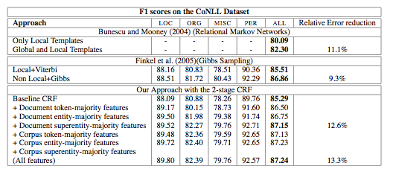
Named entity recognition: 2-stage approach: 1) CRF with local features; 2) local information and output of first CRF as features. Comparison against competitive approaches. Baseline results are shown on the first line of each approach.
[Krishnan & Manning 2006]

Slide 31
Evaluation of the supervised learning methods
Results approach the results of using hand-crafted patterns
But, for some tasks the results fall short of human capability:
  both for the hand-crafted and learned patterns
  explanation:
    high variation of natural language expressions that form the context of the information or that constitute the information
    ambiguous patterns and lack of discriminative features
    lack of world knowledge not made explicit in the text

Slide 32
Evaluation of the supervised learning methods
Annotating: tedious task !
  integration of existing knowledge resources, if conveniently available (e.g., use of dictionary of classified named entities when learning named entity classification patterns)
  the learned patterns are best treated as reusable knowledge components
  bootstrapping (weakly supervised learning)
    given a limited set of patterns manually constructed or patterns learned from annotations
    expand “seed patterns” with techniques of unsupervised learning and/or external knowledge resources

Slide 33
Less supervision?

Slide 34
Latent semantic topic models
= a class of unsupervised (or semi-supervised) models in which the semantic properties of words and documents are expressed in terms of topics
  models are also called aspect models
Latent Semantic Indexing:
  the semantic information can be derived from a word-document matrix
  [Deerweester et al. 1990]
  But, LSI is unable to capture multiple senses of a word
Probabilistic topic models
d
w

Slide 35
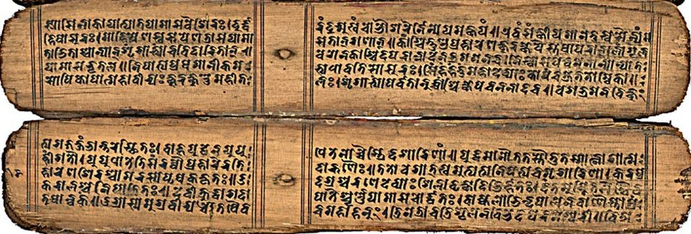
Panini
Panini = Indian grammarian (6th-4thcentury B.C. ?) who wrote a grammar for sanskrit
Realizational chain when creating natural language texts:
  Ideas -> broad conceptual components of a text -> subideas -> sentences -> set of semantic roles-> set of grammatical and lexical concepts ->character sequences
[Kiparsky 2002]

Slide 36
Probabilistic topic model
= Generative model for documents: probabilistic model by which documents can be generated
  document = probability distribution over topics
  topic = probability distribution over words
To make a new document, one chooses a distribution over topics, for each topic one draws words according to a certain distribution:
  select a document d_{j} with probability P(d_{j})
  pick a latent class z_{k} with probability P(z_{k}⎟d_{j})
  generate a word w_{i} with probability P(w_{i}⎟z_{k})
[Steyers & Griffiths 2007]

Slide 37
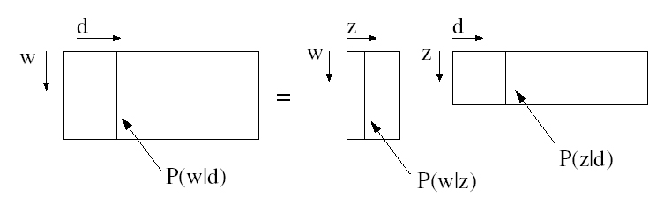
observed word
distributions
word distributions
per topic
topic distributions
per document

Slide 38
Probabilistic Latent Semantic Analysis (pLSA)
[Hofmann SIGIR 1999]
d
z
w
M = number of documents
N = number of words
N
M
waitress
John goes into the building, sits down waitress shows him menu. John orders. The waitress brings the food. John eats quickly, puts $10 on the table and leaves. ..
John goes the park with the magnolia trees and meets his friend, ...
Topic 1
$
food
Menu
...
park
Topic 2
Tree ...

Slide 39
pLSA
Translating the document or text generation process into a joint probability model results in the expression
where
K = number of topics (a priori defined)
Training = maximizing
where n(d_{j},w_{i}) = frequency of w_{i} in d_{j}
(e.g. trained with EM algorithm)

Slide 40
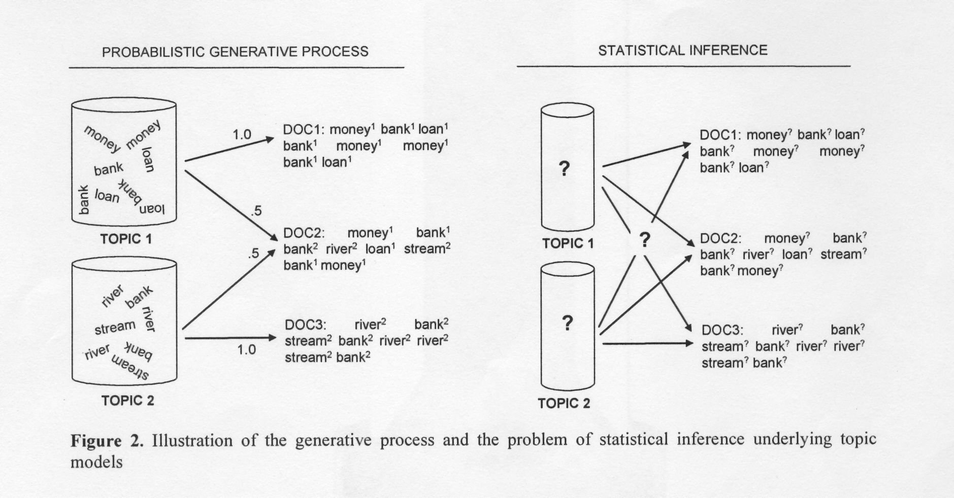
[Steyvers & Griffiths 2007]

Slide 41
Latent Dirichlet Allocation
α
θ
γ
φ
β
z
θ
z
w
N
N
M
M
(1)
(2)
[Blei et al. JMLR 2003]

Slide 42
Latent Dirichlet Allocation
pLSA: learns P(z_{k}⎟d_{j}) only for those documents on which it is trained
Latent Dirichlet Allocation (LDA) treats topic mixture weights as a k-parameter hidden random variable θ
Training
  Key inferential problem: computing the distribution of the hidden variables θ and z given a document , i.e., p(θ,z|w,α,β): intractable for exact inference
  α: Dirichlet prior, can be interpreted as a prior observation count for the number of times a topic is sampled in a document, before having observed any actual words from that document

Slide 43
Latent Dirichlet Allocation
  Model 2 = simple modification of the original graphical model 1: the chain α → θ → z is replaced by γ → θ and φ → z
  Compute approximation of model 1 by model 2 for which the KL divergence KL[p(θ,z|γ,φ), q(θ,z| w,α,β) is minimal
  Iterative updating of γ and φ for each document and recalculation of corpus-level variables α and β by means of EM algorithm
Inference for new document:
  Given α and β: we determine γ (topic distribution) and φ (word distribution) with a variational inference algorithm

Slide 44
Probabilistic topic models
Probabilistic models of text generation (cf. model of text generation by Panini)
Understanding by the machine = we infer the latent structure from which the document/text is generated
Today:
  Bag-of-words representations
  Addition of other structural information is currently limited (e.g., syntax information in [Griffiths et al. ANIPS 2004])
  But, acknowledged potential for richly structured statistical models of language and text understanding in general

Slide 45

Example
Script: human (X) taking the bus to go from LOC1 to LOC3
1. X PTRANS X from LOC1 to bus stop
2. bus driver PTRANS bus from LOC2 to bus stop
3. X PTRANS X from bus stop to bus
4. X ATRANS money from X to bus driver
5. bus driver ATRANS ticket to X
6.
7. bus driver PTRANS bus from bus stop to LOC3
8. X PTRANS X from bus to LOC3
(3), (7), (8): mandatory
[Schank 1975]
X gives money to the bus driver. ATRANS is used to express a transfer of an abstract relationship, in this case the possession of money.
Various subscripts handling actions possible during the ride.

Slide 46
Example
The doctors did not do anything to save a baby they knew was in critical trouble. Despite knowing the childbirth was in crisis, the doctors didn't do anything for more than an hour. The effects were brain damage to the baby which result in the baby having cerebral palsy, spastic quadriplegia and a seizure disorder. The child is now more than five years old, but can't walk, talk, sit or stand.
Medical malpractice

Slide 47
Example
organizational changes
misalignments of staffing
“The company experiences the leave of its product manager, and too many emplyees are allocated in the R&D section. ... For several of its projects software products are independently developed. Subsidiairies apply Western-centric approaches exclusively to local markets...“
lack of interoperability
Enterprise at risk
business conflict ?

Slide 48
Extraction of complex concepts
Semantic annotation performed by humans stretches beyond the recognition of factoids and the identification of topic distributions
Humans understand media by labeling them with abstract scenarios, concepts or issues
Very important for retrieval, mining and abstractive summarization of information, reasoning (e.g., Case Based Reasoning)
But, is this possible for a computer?

Slide 49


Fact
or Fiction

Slide 50
Problem
The complex semantic concepts: are
  not always literally present in a text
  when present, how do we know that such a concept summarizes a whole passage/document?
Given the multitude of semantic labels and the variety of natural language:
  How can the machine learn to assign the labels with only few hand-annotated examples?
  And still obtain good accuracy of the classification?

Slide 51
Solutions ?
Complex semantic concepts:
  Often hierarchically structured: composed of intermediary concepts and more simple concepts
  Cf. model of text generation by Panini
Exploit the hierarchical structure to:
  Increase accuracy ?
  Reduce number of training data ?
  Cf. current work in computer vision
[Fei-Fei & Perona IEEE CVPR 2005] [Sudderth et al. IEEE ICCV 2005]

Slide 52

[Fan et al. SIGIR 2004]

Slide 53
Solutions ?
Naive model: annotate texts and components with all kinds of semantic labels and train:
  Probably few examples/ semantic category + variety of natural language => low accuracy
Train with structured examples annotated with specific, intermediate and complex concepts
  Some tolerance for incomplete patterns =>
    possibly increased accuracy
    still many annotations

Slide 54
Solutions ?
Cascaded /network approach:
  Learning intermediate models: the output of one type of semantic labeling forms the input of more complex tasks of classification (cf. FASTUS, cf. inverse of Panini model)
    Possibly different or smaller feature sets can be used for models => less training examples needed
    Reuse of component models possible
    Natural integration of external knowledge resources
  Several aggregation possibilities: features in feature vectors, Bayesian network, ...
  But, errors propagate: keeping few best hypotheses ?
[Finke, Manning & Ng 2006] [Moens 2006]

Slide 55
Solutions ?
Extensions of the probabilistic topic models:
  Advantages of previous cascaded/network model
  Unsupervised and different levels of supervision possible
  Scalability?
  Do the unlabeled examples:
    learn us completely new patterns or only variations of existing patterns ?
    cause learning incorrect patterns?

Slide 56
References
Bakir G.H., Hofmann, T.,Schölkopf, B., Smola, A.J., Taskar, B. & Vishwanathan, S.V.N. (2007) (Eds.), Predicting Structured Data. Cambridge, MA: MIT Press.
Blei, D.M., Ng, A.Y. and Jordan, M.I. (2003). Latent Dirichlet allocation. Journal of Machine Learning Research, 3, 993-1022.
Deerwester, S., Dumais, S.T., Furnas, G.W., Landauer, T.K. & Harshman, R. (1990). Indexing by latent semantic analysis. Journal of the American Society for Information Science, 41 (6), 391-407.
Fan, J., Gao, Y., Luo, Y. & Xu, G. (2004). Automatic image annotation by using concept-sensitive salient objects for image content representation. In Proceedings of the Twenty-Seventh Annual International ACM SIGIR Conference on Research and Development in Information Retrieval (pp. 361-368). New York : ACM.
Fei-Fei, L. & Perona, P. (2005). A Bayesian hierarchical model for learning scene categories. IEEE-CVPR.
Finke, J.R., Manning, C.D. and Ng, A.Y (2006). Solving the problem of cascading errors: Approximate Bayesian inference for linguistic annotation pipelines. In Proceedings of the Conference on Empirical Methods in Natural Language Processing.

Slide 57
References
Griffiths, T.L., Steyvers, M. Blei, D.M. & Tenenbaum, J.B (2004). Integrating Topics and Syntax. Advances in Neural Information Processing Systems, 17.
Hobbs, J. R. (2002). Information extraction from biomedical text. Journal of Biomedical Informatics, 35, 260-264. [4] Hofmann, T. (1999). Probabilistic latent semantic analysis. In Proceedings of SIGIR (pp. 50-57). New York: ACM.
Kiparsky, Paul (2000). On the Architecture of Panini's Grammar. Three lectures delivered at the Hyderabad Conference on the Architecture of Grammar, January 2002, and at UCLA, March 2002.
Krishnan, V. & C.D. Manning (2006). An effective two-stage model for exploiting non-local dependencies in named entity recognition. Proceedings of COLING-ACL 2006 (pp. 1121-1128). East Stroudsburg, PA: ACL.
Moens, M.-F. (2008). Learning Computers to Understand Text, Inaugural lesson February 8, 2008.
Moens, M.-F. (2006). Information Extraction: Algorithms and Prospects in a Retrieval Context (The Information Retrieval Series 21). Berlin: Springer.

Slide 58
References
Schank, R.C. (1975). Conceptual Information Processing. Amsterdam: North Holland.
Steyvers, M. and Griffiths, T. (2007). Probabilistic topic models. In T. Landauer, D.S. McNamara, S. Dennis and W. Kintsch (Eds.), The Handbook of Latent Semantic Analysis. Hillsdale, NJ: Lawrence Erlbaum Associates.
Sudderth, E.B., Torralba, A., Feeman, W.T. and Wilsky, A.S. (2005). Learning hierarchical models of scenes, objects and parts. In Proceedings of the Tenth IEEE International Conference on Computer Vision, vol. 2 (pp. 1331-1338).
Sutton, C. & McCallum A. (2007). An introduction to Conditional Random Fields for relational learning. In L. Gtoor & B. Taskar (Eds.), Statistical Relational Learning (pp. 94-127). The MIT Press: Cambridge, MA.
Yang, Y. and Liu X. (1999). A re-examination of text categorization methods. In Proceedings of SIGIR (pp. 42-49). New York: ACM.

